Slide 1
JOB READY PROGRAM | UDFI PHILIPPINES
2,290
Students are finishing the Job Ready Program too quickly
students enrolled in the Job Ready Program
229 (10%)
Problem
How do we tell whether a student is learning too quickly, at the cost of understanding?
completed all 14 quizzes in under 11 days
~30 days
Response
An Early Warning System that alerts teachers when a student completes too many quizzes too quickly, and shows relationship managers which teachers need support.
expected course duration

Slide 2
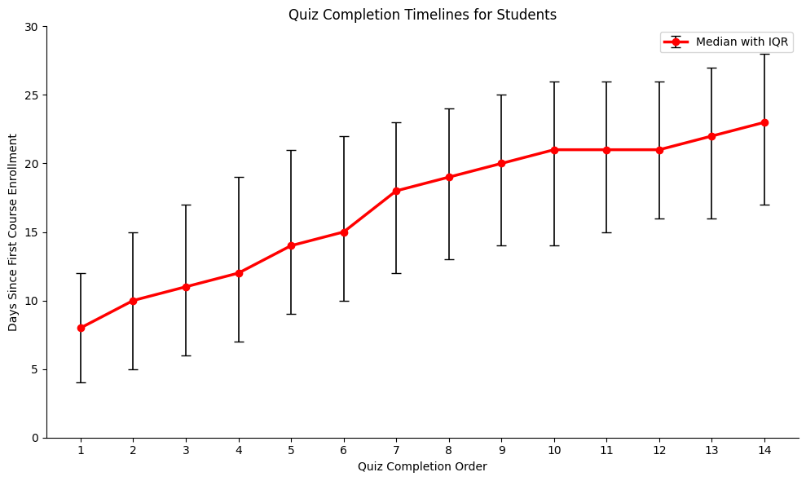
Learners finish quizzes in burst, so a simple gap rule would raise false alarms.
~8 days
Median time to complete one quiz
~23 days
Median time to complete all quizzes
Quizzes 10-12
Typically land together around day 21

Slide 3
Early finishers score lower on lessons, so Quiz 7 and Quiz 14 become our checkpoints
QUIZ 7 CHECKPOINT
7 quizzes within 2 days
QUIZ 14 CHECKPOINT
14 quizzes within 5 days
d = −0.51 p = 0.0139
Moderate effect at Quiz 7
d = −0.41 p = 0.0047
Moderate effect at Quiz 14
Thresholds are set empirically from historical completion percentiles. Students inside either window are flagged as early.
Notes:
Quiz scores were relatively similar between early and other students; the gap shows up in lesson scores. Cohen's d: -0.51 (7 quizzes), -0.41 (14 quizzes).

Slide 4


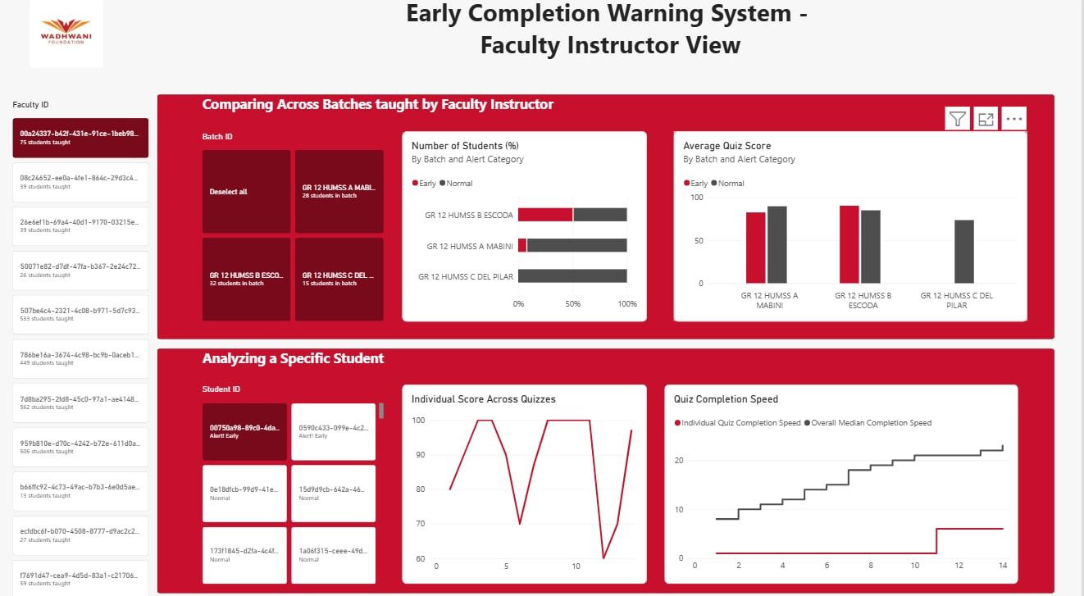
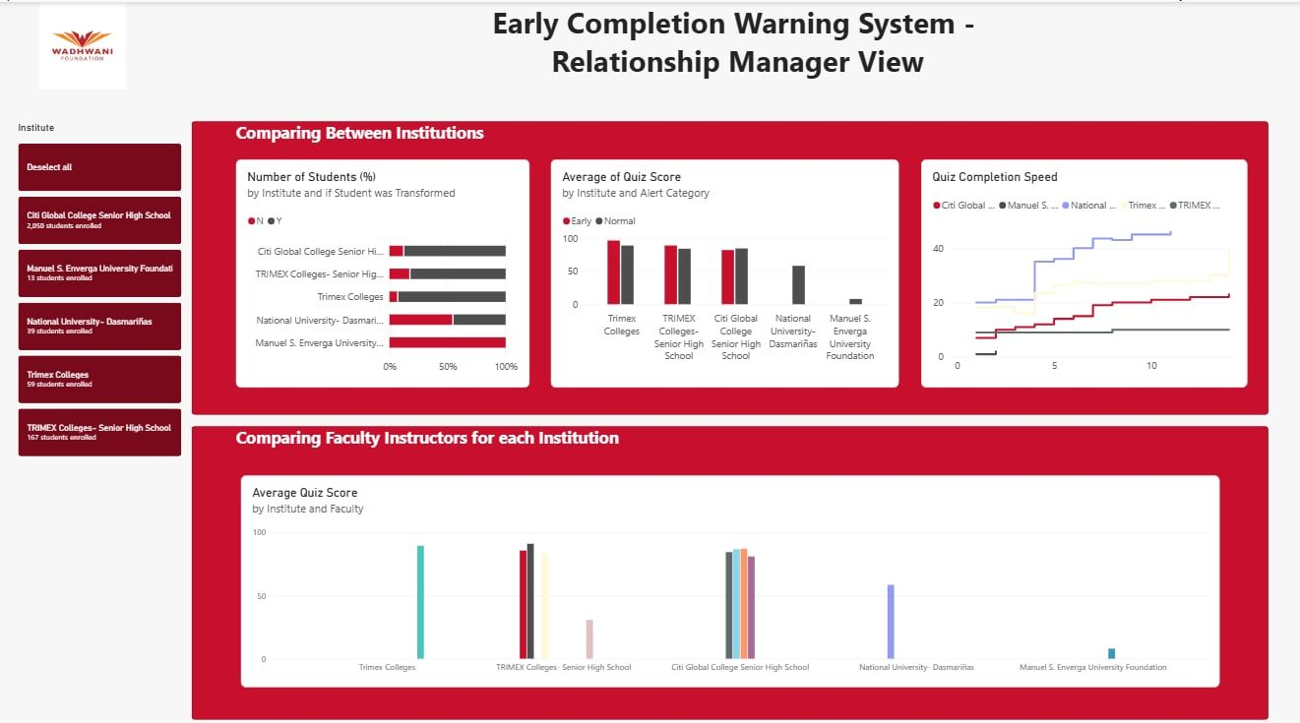
Instructors review flagged students, and relationship managers act on patterns.
Alerts for Faculty Instructors
Insights for Relationship Managers
A faculty instructor can check across the batch to see the overall health of the cohort, which would be based on the score of the quizzes.
They can also check in with the student on how they are doing and whether support is needed. They can see the a student’s journey compared to a regular student.
For the relationship manager, they can compare the institution-wide KPIs. If several teachers at one institution showing abnormal completion points to a program implementation issue, then the relationship manager can step in to support those teachers.

Slide 5



Pace is a flag, not a verdict: Outcome Linkage and Governance
Graduation
Scalable verification
Governance
Fast completers stay eligible if they meet program requirements.
The EWS flags unusual pacing, not failure.
Lessons and transformation rate are checked alongside quizzes.
The relationship manager stays the primary coordinator.
Teachers review the students flagged in their batches.
Relationship managers monitor patterns across teachers and institutions.
Teachers see only their own batches; managers only their institutions.
Thresholds are empirical, so review them with every new batch.

